Slide 1

Sales Meeting
Customer
Mest & Products, Inc.
Date
2026-03-16
Quotation
No. 000000

Slide 2
Sales & Shipments, Last 3 Years
Sales: 2022-01-01~2022-12-31: US$0 2023-01-01~2023-12-31: US$11,172 (∞) 2024-01-01~2024-12-31: US$36,000 (222.2%)
Shipments: 2022-01-01~2022-12-31: US$0 2023-01-01~2023-12-31: US$7,793 (∞) 2024-01-01~2024-12-31: US$2,000 (-74.3%)

Slide 3
Ranked Items Sold in the Last Year

Slide 4
Rank:
1
Customer Item No.:
Our Item No.:
000000046
Amount:
US$72,000
Quantity:
3,600 pc
Porcelain teapot
4-1/2" high. Note: this pot is for decorate purpose only. Don't use it on an oven. The manufacturer shall not be held responsible for any misuse on the part of the user.

Slide 5
Rank:
2
Customer Item No.:
Our Item No.:
000000047
Amount:
US$4,800
Quantity:
1,200 pc
7436A Porcelain tiny girl w/pontail & 2 red bows w/1153c hands.
Packing: head w/hands/ppbg w/3" hdr, 3bg/Mbg, 480set/ctn

Slide 6
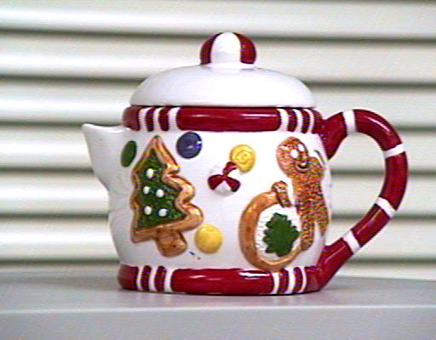
Rank:
3
Customer Item No.:
Our Item No.:
000000012345
Amount:
US$2,000
Quantity:
100 pc
Porcelain teapot, 4-1/2" high. 日本語ワープロ検定試験問題。Porcelain teapot, 4-1/2" high. 放些中文或其他語言 here. Not to be held responsible for any misuse on the part of the user .日本語ワープロ検定試験問題。

Slide 7
Items to Offer Now

Slide 8
Customer Item No.:
Item No.:
000000012345
Porcelain teapot, 4-1/2" high. 放些中文或其他語言 here. Not to be held responsible for any misuse on the part of the user .日本語ワープロ検定試験問題。Porcelain teapot, 4-1/2" high. 放些中文或其他語言 here. Not to be held responsible for any misuse on the part of the user .日本語ワープロ検定試験問題。
NT$3.00/pc C&F CHASKA, MN | Pack | Cube | G.W.
40' Container: 3,744 pc | 12 | 8.680 cu.ft. | 20.00 kg

Slide 9
Customer Item No.:
Item No.:
000000013
X'mas Stocking.
100% Acrylic material
NT$0.00/pc C&F CHASKA, MN | Pack | Cube | G.W.
 | 4 | 0.100 cu.ft. | 11.00 kg

Slide 10
Customer Item No.:
Item No.:
0000011FS-134585
1234567890123456789012345678901234567890123456789A123467890123456789012345678901234567890123456789B1234567890123456789012345678901234567890123456789C
NT$0.46/pc FOB FUZHOU | Pack | Cube | G.W.
 | 100 | 1.600 cu.ft. | 17.00 kg

Slide 11
Customer Item No.:
Item No.:
11198-CK
FLOWER STALL CLOCK/8805
NT$10.76/doz FOB Taiwan | Pack | Cube | G.W.
 | 1.0 | 0.069 cu.ft. | 14.10 kg

Slide 12
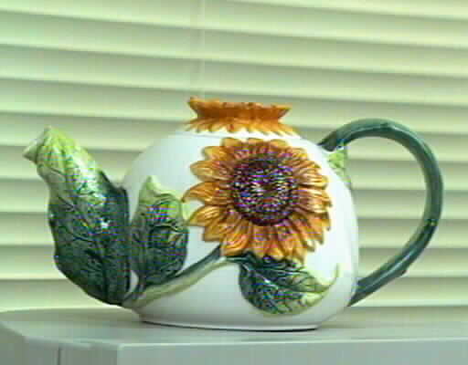
Customer Item No.:
Item No.:
TEST160411
Porcelain teapot
4-1/2" high. Note: this pot is for decorate purpose only. Don't use it on an oven. The manufacturer shall not be held responsible for any misuse on the part of the user.
NT$1.61/pc C&F CHASKA, MN | Pack | Cube | G.W.
40' Container: 1,344 pc | 12 | 1.000 cu.ft. | 6.80 kg

Slide 13
Customer Item No.:
000000046A
Item No.:
000000046
Porcelain teapot
4-1/2" high. Note: this pot is for decorate purpose only. Don't use it on an oven. The manufacturer shall not be held responsible for any misuse on the part of the user.
NT$57.47/pc FOB | Pack | Cube | G.W.
40' Container: 14,160 pc | 10 | 1.340 cu.ft. | 4.50 kg

Slide 14
Customer Item No.:
0000002
Item No.:
970001011
fjhk hjlk'ip;igfjmhg ghljkl jlk; fjhlk;lk; hlk;l gfkjl gkj;gkjk
NT$0.17/pc FOB YANTIAN | Pack | Cube | G.W.
 | 0 | 0.210 cu.ft. | 0.00 kg

Slide 15
Customer Item No.:
001
Item No.:
000000012345a
Porcelain teapot, 4-1/2" high. 111
Each in a white box.
NT$30.75/pc FOB | Pack | Cube | G.W.
 | 12 | 1.200 cu.ft. | 7.20 kg

Slide 16
Customer Item No.:
13
Item No.:
000000047B
Porcelain teapot, 4-1/2" high.
Each in a white box.
Note: this pot is for decorative purpose only. Don't use it on an oven. The manufacturer shall not be held responsible for any misuse on the part of the user.
NT$26.42/pc FOB CHASKA, MN | Pack | Cube | G.W.
40' Container: 151,968 pc | 8 | 0.100 cu.ft. | 7.00 kg

Slide 17
Customer Item No.:
C0323
Item No.:
000000060
1.5" X 2.0" Yellow
SILVERPLATED OBLONG TRAY WITH GOLD HANDLE. SIZE: 420 X 305 MM (16-1/2 X 12") BY COLOR BOX PACKING
1.5" X 2.0" YELLOW
SILVERPLATED OBLONG TRAY WITH GOLD HANDLE. SIZE: 420 X 305 MM (16-1/2 X 12") BY COLOR BOX PACKING
NT$165.04/doz FOB FUZHOU | Pack | Cube | G.W.
40' Container: 21,830 doz | 15.0 | 0.000 cu.ft. | 7.00 kg

